Slide 1
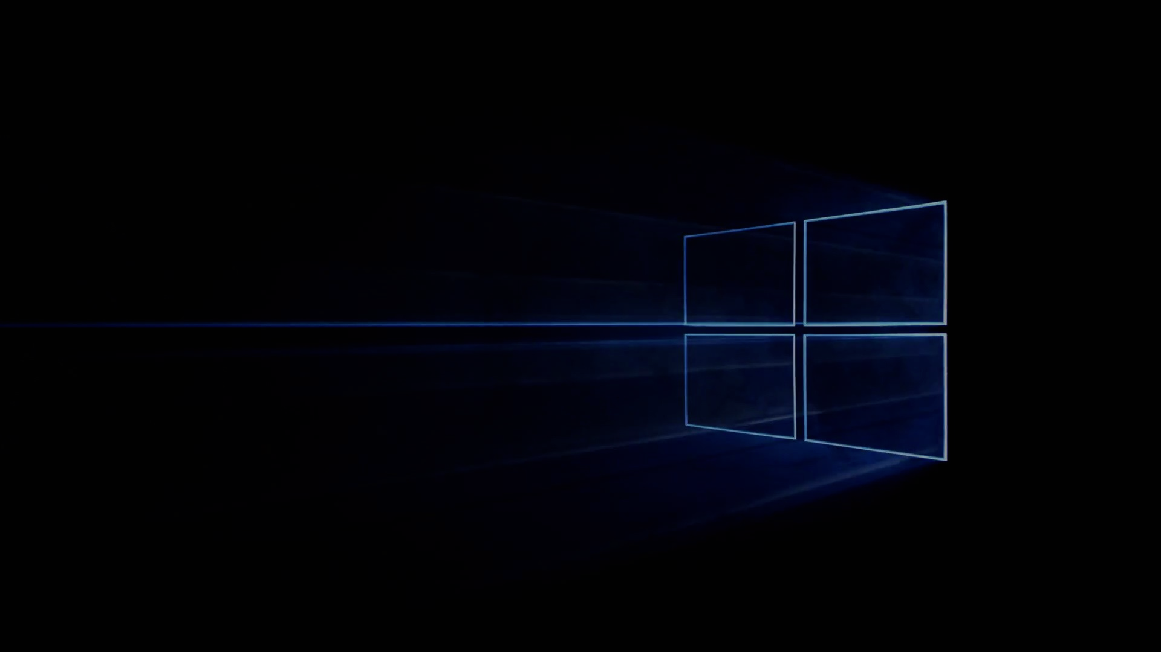
Windows 10
Group 5 박병준, 이동우, 정태호, 정현진

Slide 2
Introduction
About Windows 10
Usage of operating system
Comparison with Windows 8
Features of Windows 10
Architecture of Windows 10

Slide 3
About Windows 10
Released in July 29, 2015 by Microsoft
Windows : Graphical operating system Operating system shell for MS-DOS in GUI (Graphical User Interface)
Developed language : C++, C#, C
Supporting platform : IA-32, x86-64
Priority based preemptive thread scheduling
Completely asynchronous I/O model

Slide 4
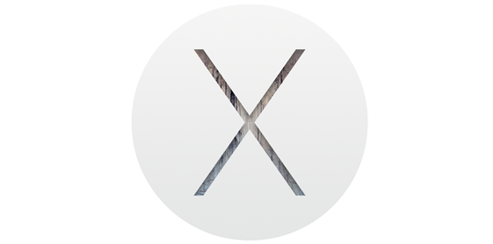

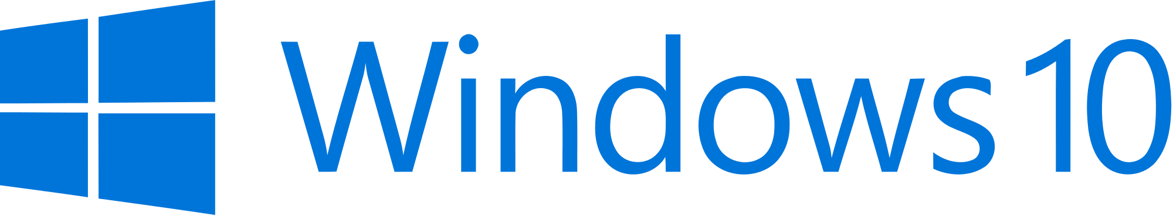
Usage of Operating System
86.27%
9.02%
1.57%
Stat Counter Global Stats (Operating System), http://gs.statcounter.com/#desktop-os-ww-monthly-201510-201510-bar, Oct 2015

Slide 5
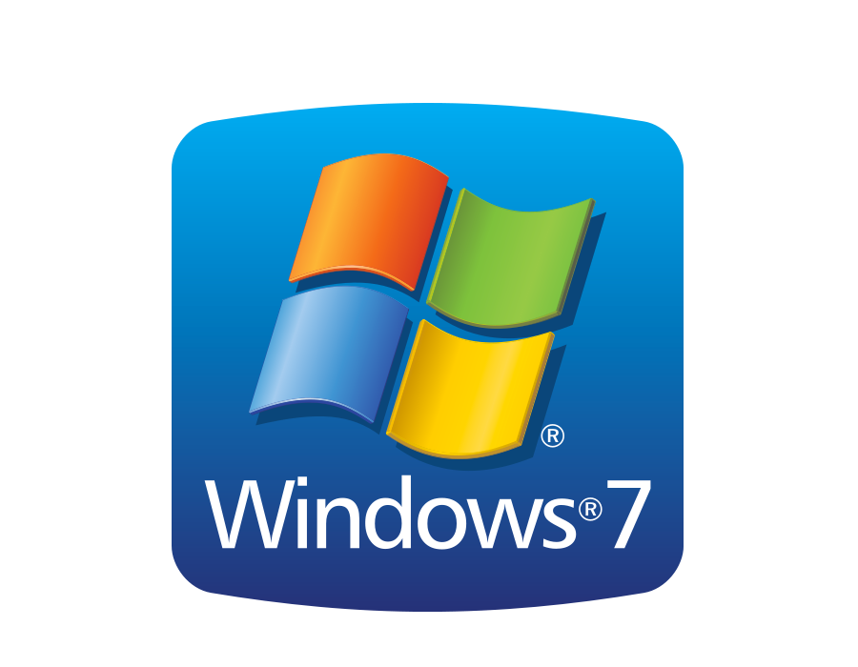
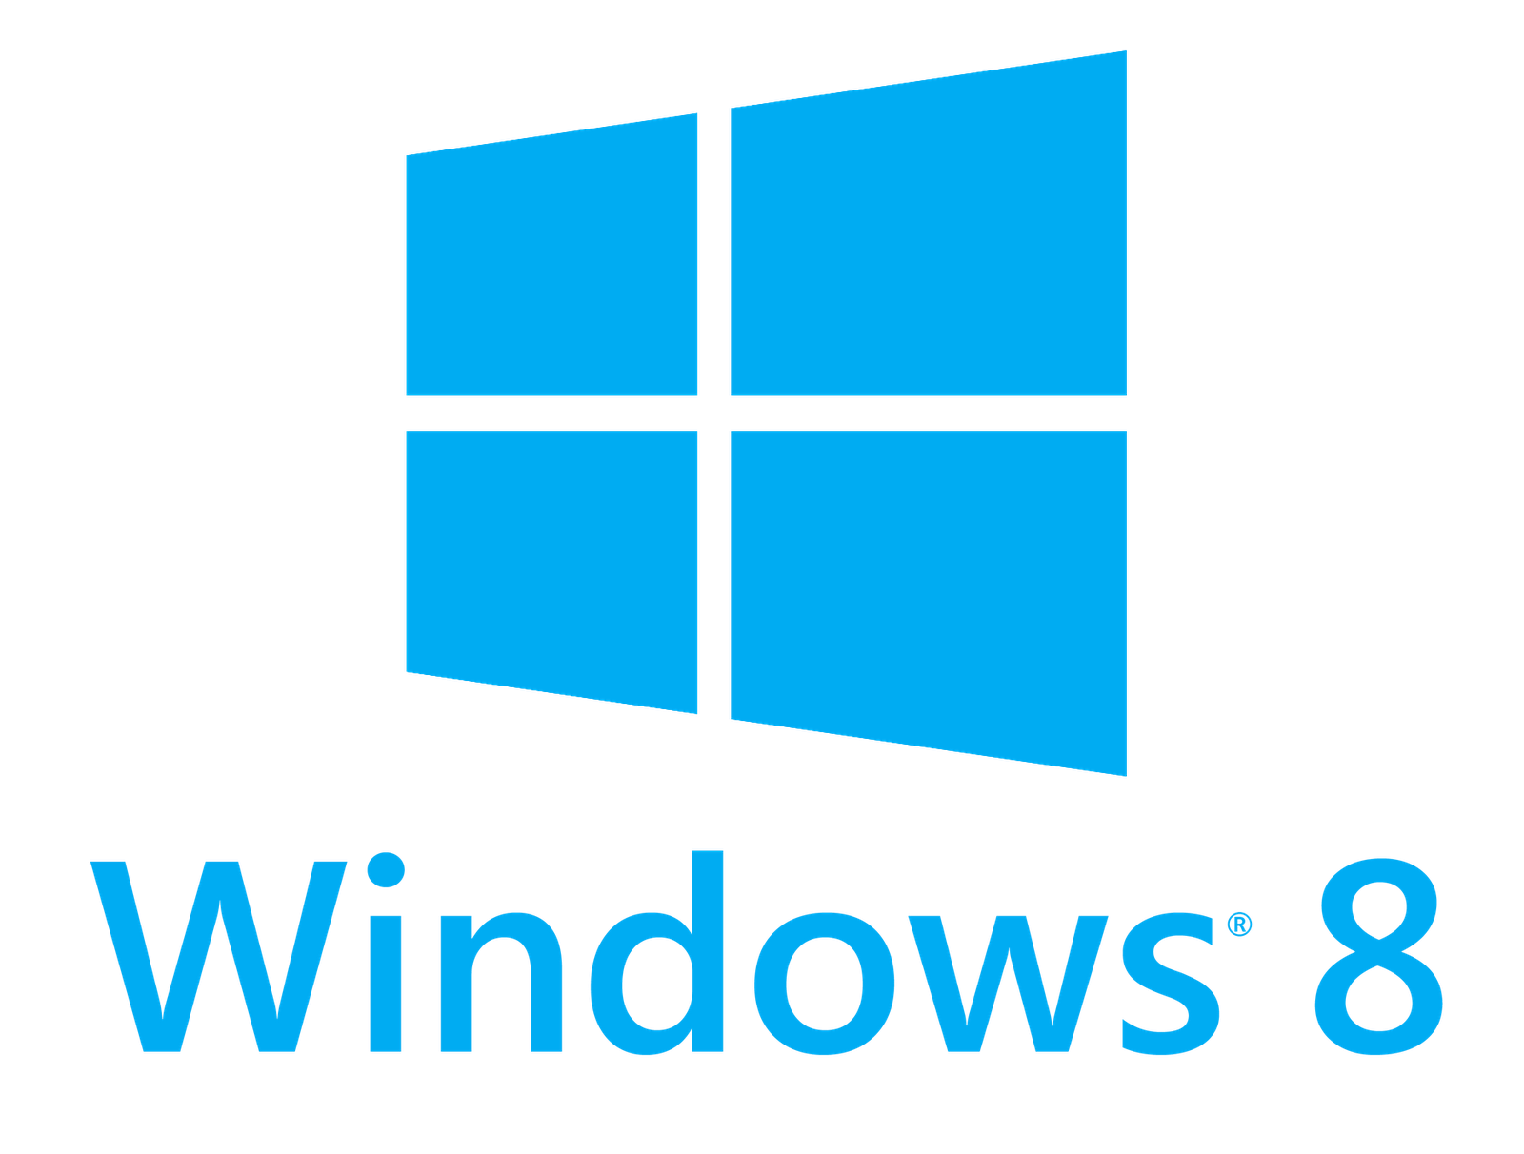
Usage in Windows
62.44%
14.71%
7.32%
Venture Beat, Emil Protalinski, http://venturebeat.com/2015/10/01/windows-10-grabs-6-63-market-share-linux-finally-passes-windows-vista/, Oct 1 2015

Slide 6
Comparison with Windows 8
Features | Windows 8 | Windows 10
Types | 4 Types x86 Software (64bit, 32bit), Windows RT, Windows phone 8 | Universal
Start Menu | Full screen | Partial
Assistance | - | Cortana
Search | In start menu | Next to start menu
Splitting screen | Full screen | Up to four apps (Virtual desktop system)
X Box Apps | Limited usage | Built-in X Box

Slide 7
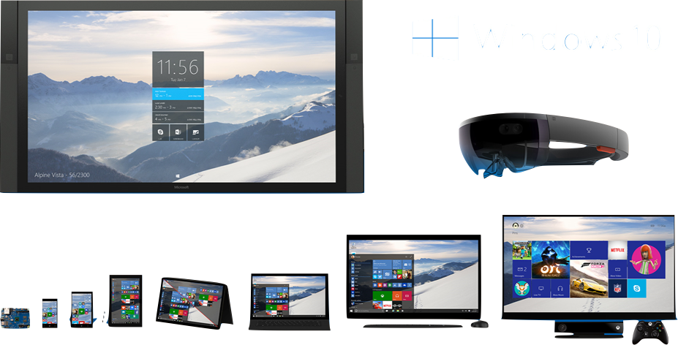
Features - Universal

Slide 8
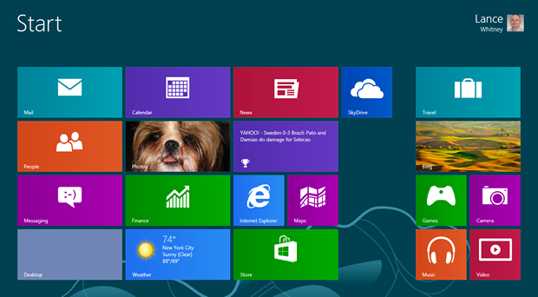
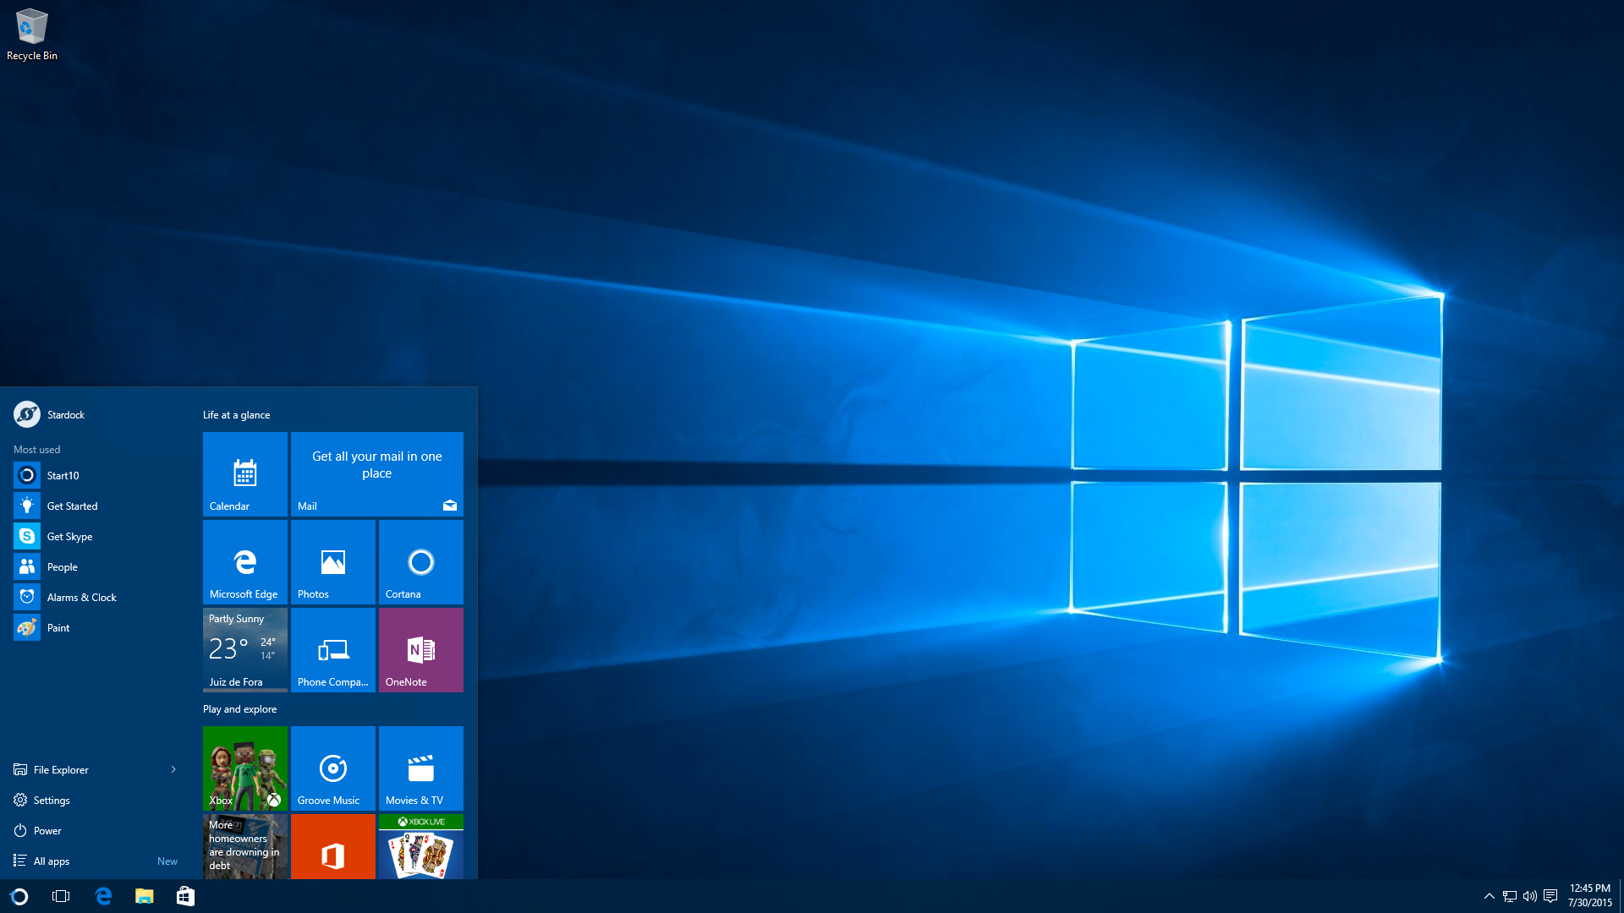
Features - Start Menu
Windows 8
Windows 10

Slide 9
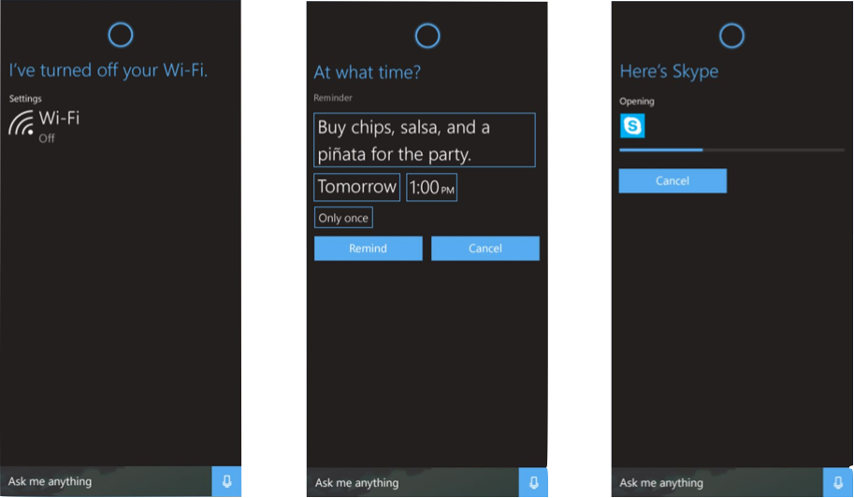
Features - Cortana

Slide 10
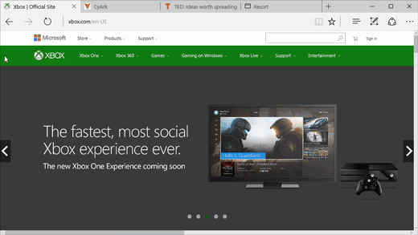
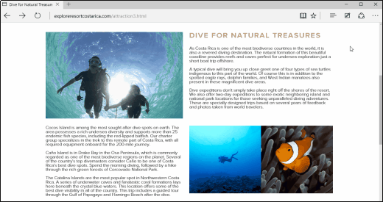
Features - Edge

Slide 11
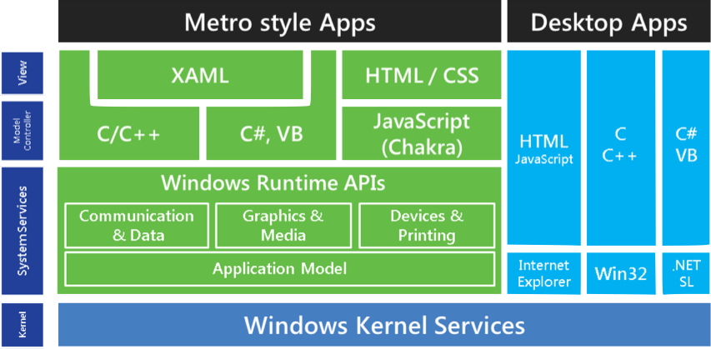
Architecture of Windows 10

Slide 12
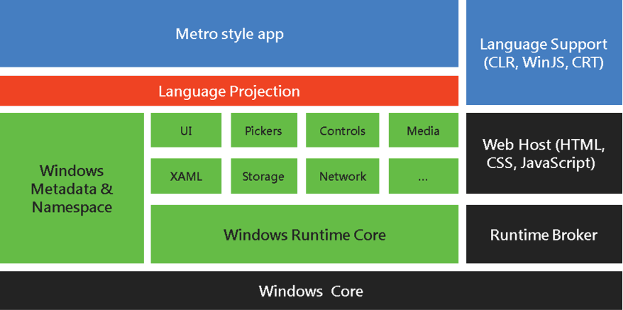
Windows Runtime Architecture

Slide 13
Windows Runtime Architecture
C++ Object oriented design
API based on Component Object Model (COM)
API definitions stored in ‘.winmd’ files
Applications run within a sandbox for protection
Applications are packaged in .appx file format

Slide 14
Thank you!

